Slide 1
Unit-4

Slide 2
A disk is a random-access addressable device. Transfer of data between main memory and disk takes place in units of disk blocks.
The hardware address of a block - a combination of a cylinder number, track number (surface number within the cylinder on which the track is located), and block number (within the track)-is supplied to the disk I/O (input/output) hardware.
The division of a track into equal-sized disk blocks (or pages) is set by the operating system during disk formatting (or initialization).
Block size is fixed during initialization and cannot be changed dynamically.

Slide 3
Interfacing Disk Drives to Computer Systems
A disk controller controls the disk drive and interfaces it to the computer system.
One of the standard interfaces used for disk drives on PCs and workstations was called SCSI (small computer system interface).
Today to connect HDDs, CDs, and DVDs to a computer, the interface of choice is SATA. SATA stands for serial ATA, wherein ATA represents attachment; so, SATA becomes serial AT (Advanced Technology) attachment.
Another popular interface used today is called SAS (serial attached SCSI).

Slide 4
The controller accepts high-level I/O commands and takes appropriate action to position the arm and causes the read/write action to take place.
To transfer a disk block, given its address, the disk controller must first mechanically position the read/write head on the correct track. The time required to do this is called the seek time.
There is another delay called the rotational delay or latency—while the beginning of the desired block rotates into position under the read/write head. It depends on the rpm of the disk.
Finally, some additional time is needed to transfer the data; this is called the block transfer time.
Hence, the total time needed to locate and transfer an arbitrary block, given its address, is the sum of the seek time, rotational delay, and block transfer time.

Slide 5
The seek time and rotational delay are usually much larger than the block transfer time.
To make the transfer of multiple blocks more efficient, it is common to transfer several consecutive blocks on the same track or cylinder.
This eliminates the seek time and rotational delay for all but the first block and can result in a substantial saving of time when numerous contiguous blocks are transferred.
Usually, the disk manufacturer provides a bulk transfer rate for calculating the time required to transfer consecutive blocks.

Slide 6
Buffering of Blocks
The term buffer to refer to a part of main memory that is available to receive blocks or pages of data from disk.
When several blocks need to be transferred from disk to main memory and all the block addresses are known, several buffers can be reserved in main memory to speed up the transfer.
While one buffer is being read or written, the CPU can process data in the other buffer because an independent disk I/O processor (controller) exists that, once started, can proceed to transfer a data block between memory and disk independent of and in parallel to CPU processing.

Slide 7
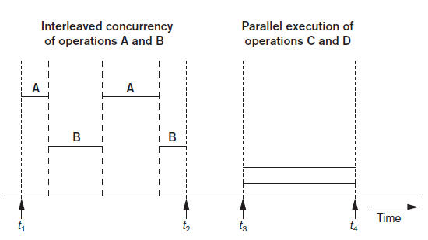
Interleaved concurrency versus parallel execution
Buffering is most useful when processes can run concurrently in a parallel fashion, either because a separate disk I/O processor is available or because multiple CPU processors exist

Slide 8
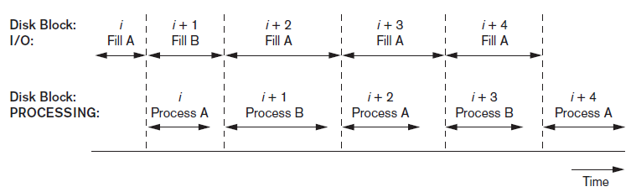
Use of two buffers, A and B, for reading from disk
When the time required to process a disk block in memory is less than the time required to read the next block and fill a buffer, reading and processing can proceed in parallel.

Slide 9
The CPU can start processing a block once its transfer to main memory is completed; at the same time, the disk I/O processor can be reading and transferring the next block into a different buffer. This technique is called double buffering and can also be used to read a continuous stream of blocks from disk to memory.

Slide 10
Buffer management and Replacement Strategies
Buffer manager is a software component of a DBMS that responds to requests for data and decides what buffer to use and what pages to replace in the buffer to accommodate the newly requested blocks.
The buffer manager views the available main memory storage as a buffer pool, which has a collection of pages.
There are two kinds of buffer managers; the first kind controls the main memory directly, as in most RDBMSs. The second kind allocates buffers in virtual memory, which allows the control to transfer to the operating system (OS).

Slide 11
The overall goal of the buffer manager is twofold:
to maximize the probability that the requested page is found in main memory, and
in case of reading a new disk block from disk, to find a page to replace that will cause the least harm in the sense that it will not be required shortly again.
To enable its operation, the buffer manager keeps two types of information on hand about each page in the buffer pool:
A pin-count: the number of times that page has been requested, or the number of current users of that page. If this count falls to zero, the page is considered unpinned. Initially the pin-count for every page is set to zero. Incrementing the pin-count is called pinning. In general, a pinned block should not be allowed to be written to disk.
A dirty bit: which is initially set to zero for all pages but is set to 1 whenever that page is updated by any application program.

Slide 12
When a certain page is requested, the buffer manager takes following actions: It checks if the requested page is already in a buffer in the buffer pool;
if so, it increments its pin-count and releases the page.
If the page is not in the buffer pool, the buffer manager does the following:
It chooses a page for replacement, using the replacement policy, and increments its pin-count.
If the dirty bit of the replacement page is on, the buffer manager writes that page to disk by replacing its old copy on disk. If the dirty bit is not on, this page is not modified, and the buffer manager is not required to write it back to disk.
It reads the requested page into the space just freed up.
The main memory address of the new page is passed to the requesting application.

Slide 13
Buffer Replacement Strategies:
Least recently used (LRU): The strategy here is to throw out that page that has not been used (read or written) for the longest time.
Clock policy: This is a round-robin variant of the LRU policy
First-in-first-out (FIFO): Under this policy, when a buffer is required, the one that has been occupied the longest by a page is used for replacement.

Slide 14
Placing File Records on Disk
Data in a database is regarded as a set of records organized into a set of files.
A file is a sequence of records.
In many cases, all records in a file are of the same record type.
A file may have fixed-length records or variable-length records.
A file may have variable-length records for several reasons:
The file records are of the same record type, but one or more of the fields are of varying size (variable-length fields) or the fields may have multiple values for individual records, or the fields are optional.
The file contains records of different record types and hence of varying size (mixed file).

Slide 15
Operations on Files
Open. Prepares the file for reading or writing. Allocates appropriate buffers (typically at least two) to hold file blocks from disk and retrieves the file header. Sets the file pointer to the beginning of the file.
Reset. Sets the file pointer of an open file to the beginning of the file.
Find (or Locate). Searches for the first record that satisfies a search condition. Transfers the block containing that record into a main memory buffer (if it is not already there). The file pointer points to the record in the buffer, and it becomes the current record.
Read (or Get). Copies the current record from the buffer to a program variable in the user program. This command may also advance the current record pointer to the next record in the file, which may necessitate reading the next file block from disk.
FindNext. Searches for the next record in the file that satisfies the search condition. Transfers the block containing that record into a main memory buffer (if it is not already there). The record is located in the buffer and becomes the current record.

Slide 16
Delete. Deletes the current record and (eventually) updates the file on disk to reflect the deletion.
Modify. Modifies some field values for the current record and (eventually) updates the file on disk to reflect the modification.
Insert. Inserts a new record in the file by locating the block where the record is to be inserted, transferring that block into a main memory buffer (if it is not already there), writing the record into the buffer, and (eventually) writing the buffer to disk to reflect the insertion.
Close. Completes the file access by releasing the buffers and performing any other needed cleanup operations.
The preceding (except for Open and Close) are called
record-at-a-time operations

Slide 17
It is possible to streamline the operations Find, FindNext, and Read into a single operation, Scan, whose description is as follows:
Scan: If the file has just been opened or reset, Scan returns the first record; otherwise it returns the next record. If a condition is specified with the operation, the returned record is the first or next record satisfying the condition.
Set-at-a-time (higher-level) operations
FindAll: Locates all the records in the file that satisfy a search condition.
Find (or Locate) n: Searches for the first record that satisfies a search condition and then continues to locate the next n − 1 records satisfying the same condition. Transfers the blocks containing the n records to the main memory buffer (if not already there).
FindOrdered: Retrieves all the records in the file in some specified order.
Reorganize: Starts the reorganization process. As we shall see, some file organizations require periodic reorganization. An example is to reorder the file records by sorting them on a specified field.

Slide 18
Heap Files
The simplest and most basic type of organization where records are placed in the file in the order in which they are inserted, so new records are inserted at the end of the file. Such an organization is called a heap or pile file.
It is the simplest and most basic type of organization. It works with data blocks. In heap file organization, the records are inserted at the file's end. When the records are inserted, it doesn't require the sorting and ordering of records.
When the data block is full, the new record is stored in some other block. This new data block need not to be the very next data block, but it can select any data block in the memory to store new records. The heap file is also known as an unordered file.
In the file, every record has a unique id, and every page in a file is of the same size. It is the DBMS responsibility to store and manage the new records.

Slide 19
If the database is very large then searching, updating or deleting of record will be time-consuming because there is no sorting or ordering of records. In the heap file organization, we need to check all the data until we get the requested record.

Slide 20
Files of Ordered Records (Sorted Files)
Ordering the records of a file on disk based on the values of one of
their fields-called the ordering field. This leads to an ordered or sequential (Sorted) file.
If the ordering field is also a key field of the file-a field guaranteed to have a unique value in each record—then the field is called the ordering key for the file.

Slide 21
Ordered records have some advantages over unordered files.
First, reading the records in order of the ordering key values becomes extremely efficient because no sorting is required. The search condition may be of the type < key = value>, or a range condition such as < value1 < key < value2>.
Second, finding the next record from the current one in order of the ordering key usually requires no additional block accesses because the next record is in the same block as the current one (unless the current record is the last one in the block).
Third, using a search condition based on the value of an ordering key field results in faster access when the binary search technique is used, which constitutes an improvement over linear searches, although it is not often used for disk files.
Ordered files are blocked and stored on contiguous cylinders to minimize the seek time.

Slide 22
Secondary Access Paths
The index structures are additional files on disk that provide secondary access paths, which provide alternative ways to access the records without affecting the physical placement of records in the primary data file on disk.
They enable efficient access to records based on the indexing fields that are used to construct the index.
Basically, any field of the file can be used to create an index, and multiple indexes on different fields-as well as indexes on multiple fields-can be constructed on the same file.

Slide 23
Types of Single-Level Ordered Indexes
For a file with a given record structure consisting of several fields (or attributes), an index access structure is usually defined on a single field of a file, called an indexing field (indexing attribute).
The index typically stores each value of the index field along with a list of pointers to all disk blocks that contain records with that field value.
A primary index is specified on the ordering key field of an ordered file of records.

Slide 24
If the ordering field is not a key field-that is, if numerous records in the file can have the same value for the ordering field-another type of index, called a clustering index, can be used.
A third type of index, called a secondary index, can be specified on any non-ordering field of a file.

Slide 25
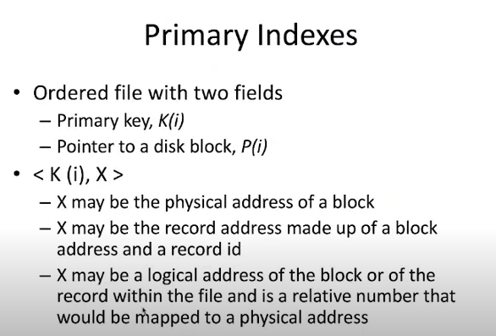

Slide 26
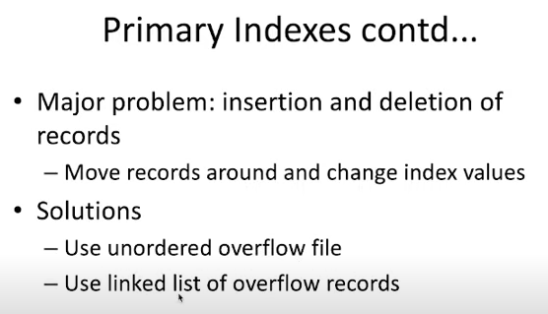

Slide 27
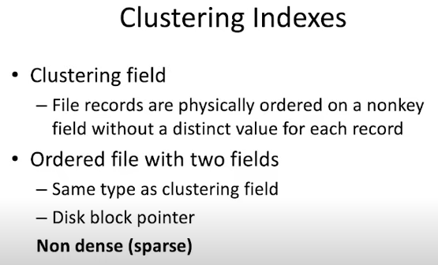

Slide 28
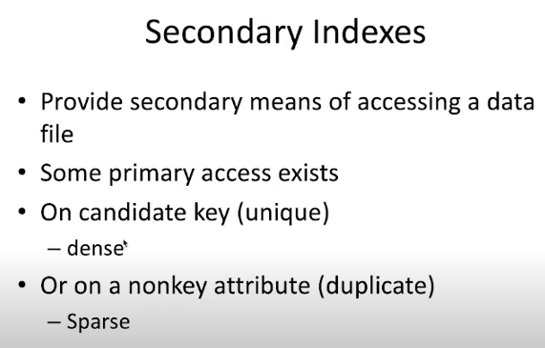

Slide 29
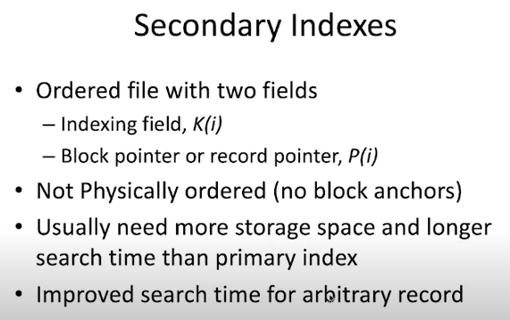

Slide 30
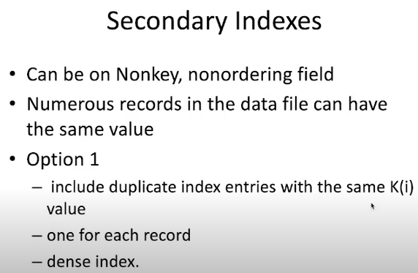

Slide 31
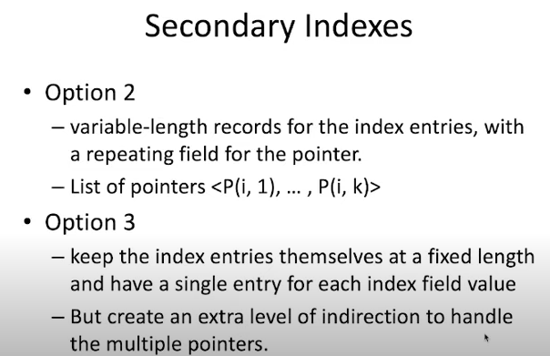

Slide 32
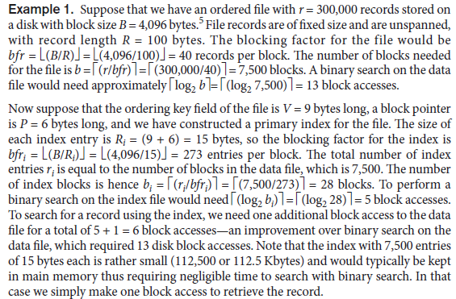

Slide 33
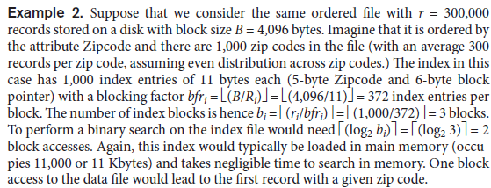

Slide 34
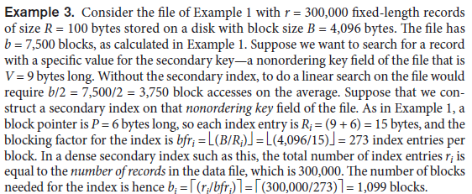

Slide 35
Multilevel Indexes
If both the record size and the number of records in a file are small, some DBMSs offer the option of a B-tree data structure as the primary file organization.
B-trees and B+-trees are special cases of the well-known search data structure known as a tree.

Slide 36
A tree is formed of nodes.
Each node in the tree, except for a special node called the root, has one parent node and zero or more child nodes.
The root node has no parent.
A node that does not have any child nodes is called a leaf node;
A non-leaf node is called an internal node. The level of a node is always one more than the level of its parent, with the level of the root node being zero.
A subtree of a node consists of that node and all its descendant nodes-its child nodes, the child nodes of its child nodes, and so on.
A precise recursive definition of a subtree is that it consists of a node n and the subtrees of all the child nodes of n.

Slide 37
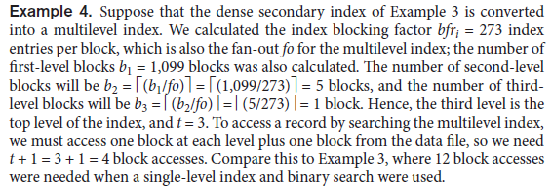

Slide 38
Dynamic Multilevel Indexes

Slide 39
Dynamic Multilevel Indexes Using B-Trees

Slide 40
Dynamic Multilevel Indexes Using B+ Trees

